Slide 1
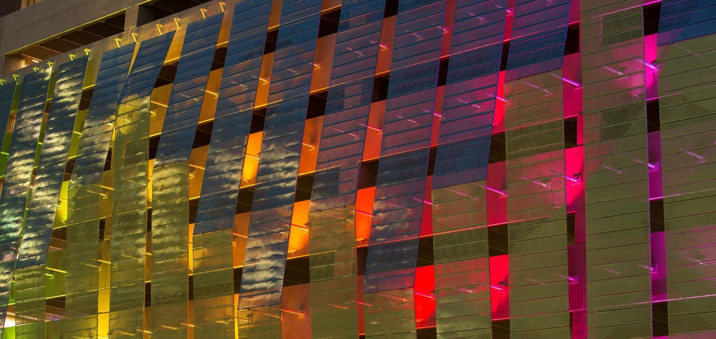

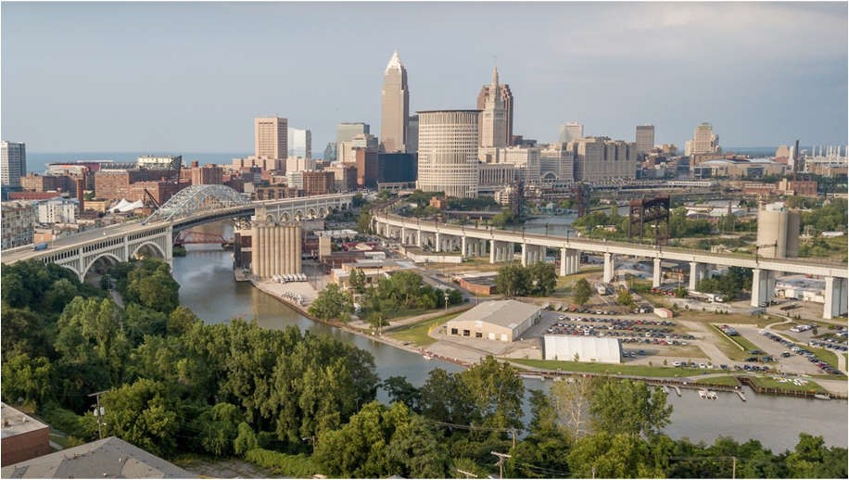

CITY OF CLEVELAND
Parking Meter System Enhancement Project

Slide 2

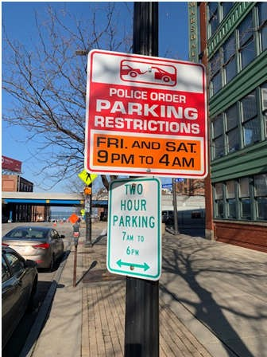
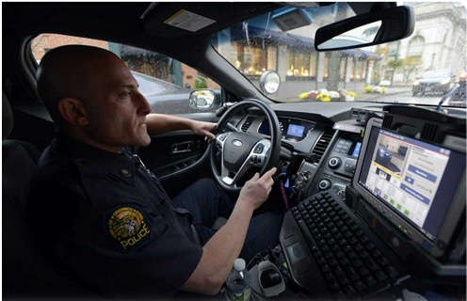
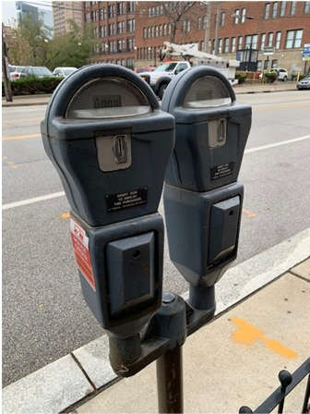
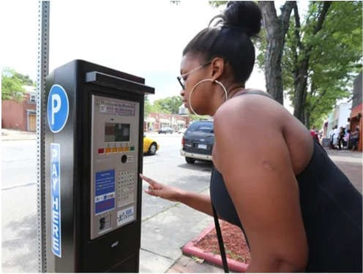
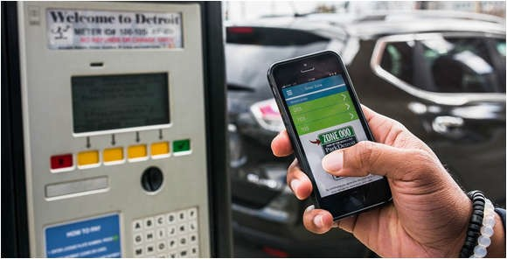

PRESENTATION AGENDA
Summary of Meter System Modernization Plan
  System Hardware and Services Procurement
  Programmatic and Regulatory Changes
Phased Implementation
Procurement Budget
Return on Investment
Procurement Process
Questions/Answers

Slide 3
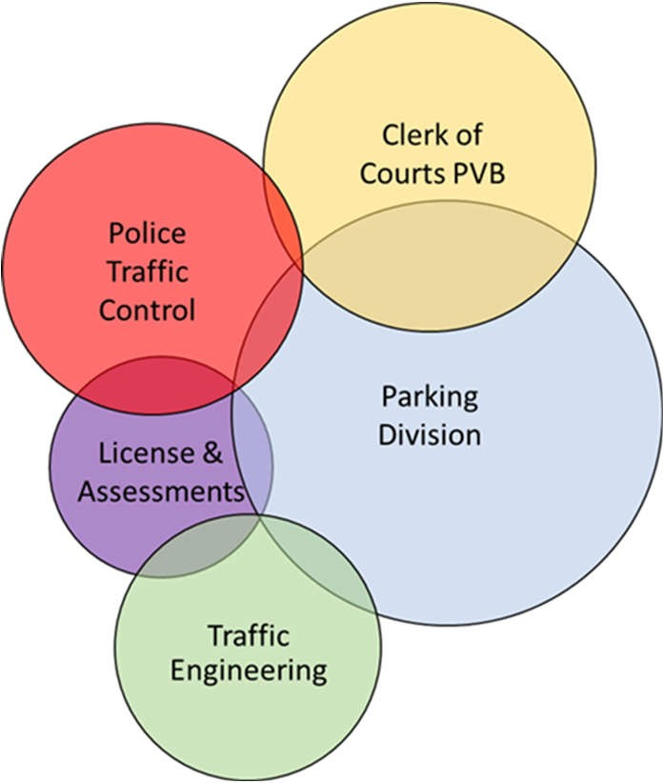
METER SYSTEM MODERNIZATION RATIONALE
Customer-friendly and convenient.
Unclutter the pedestrian right-of-way.
Compliment/support mission of other departments and agencies.
More efficient and effective enforcement.
Operating expense reduction.
Stronger financial performance outcome.
Enhanced management capability (to monitor, analyze and respond to parking problems/ opportunities).

Slide 4

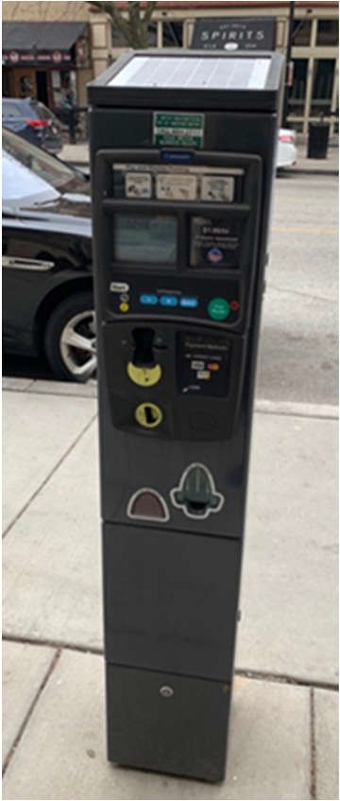
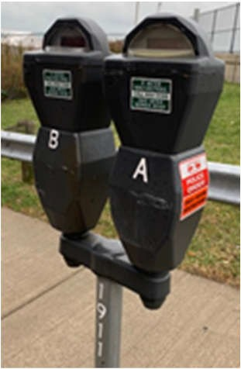
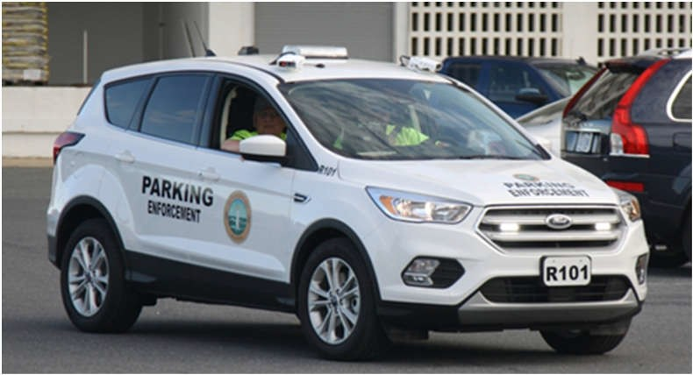
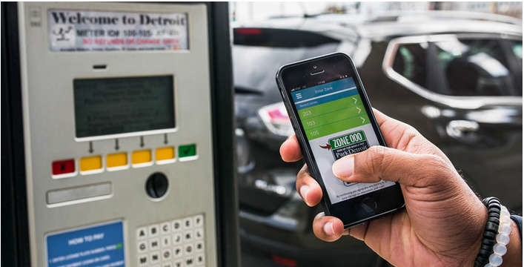
SYSTEM MODERNIZATION PLAN
New Hardware and Services:
Single-Space Meters to Multi-Space Pay Stations
Mobile License Plate Based Enforcement
Pay-by-Phones Service

Slide 5
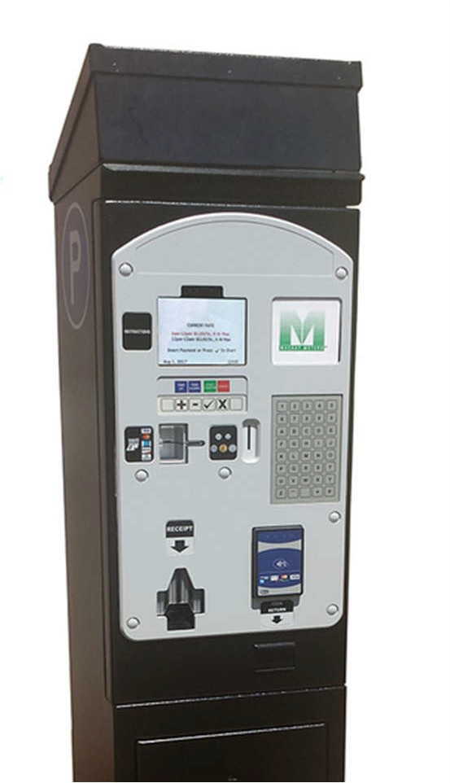
SYSTEM MODERNIZATION PLAN
System-Wide Deployment of all Multi-Space Pay Station Kiosks
Fewer units required (1 Unit will replace 8 single meters)
Fewer units with self-diagnostic (lower maintenance cost)
Credit card enabled with near-field/cellphone payment processing
Real-Time Analytics (usage/receipts audits/reduced collection cost)
Solar powered with long-life battery-backup
4G/5G wireless communication
Alpha-numeric keypad for license plate entries
Daisy chain unit linkages (pay for more time from any remote unit)
Programmable to accept citation payments

Slide 6
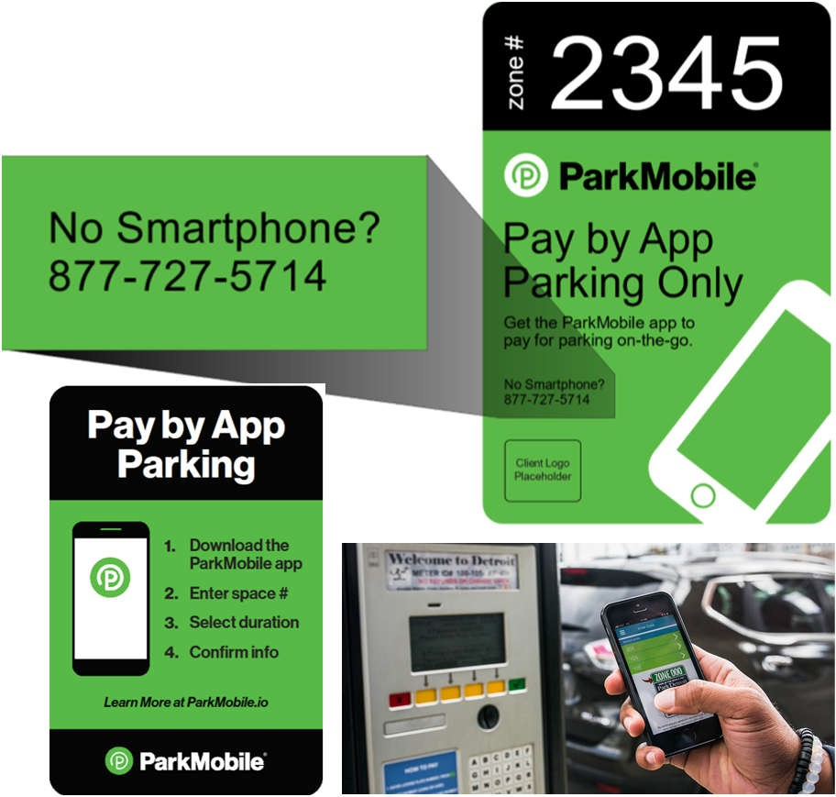
SYSTEM MODERNIZATION PLAN
Pay-by-Phone Service
No acquisition cost to City
Works with both regular and smart cellphones
Credit card processing fee paid by users
Reduces Meter Unit Collection Burden
Capacity to communicate with customers

Slide 7
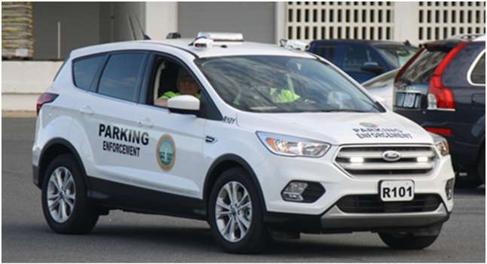
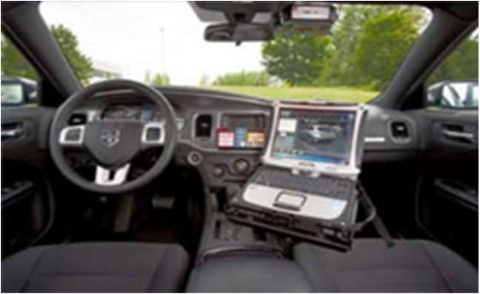
SYSTEM MODERNIZATION PLAN
Mobile “Pay-by-Plate” LPR enforcement
Expanded enforcement patrol coverage/frequency
Potential to reduce enforcement staff
Rapid transmittals of citations to processing entity
Hot list plates, scofflaw offenders and “Amber Alerts”
Full integration with pay-by-phone service
Digital chalking of parked vehicles
Recognizes VIP and virtual permits in designated zones
Violation mapping by block, zone and time of day
Data collection on parking supply/demand patterns

Slide 8
SYSTEM MODERNIZATION PLAN
Programmatic and Regulatory Changes:
Strongly Recommended:
Change to “Pay-by-Plate” for transaction processing and enforcement
System-Wide Rate Increase ($1.00 and $1.50 Per hour)
Expansion of paid parking into new high demand areas
Establish more locations where 4-hour parking time limits are allowed in CBD
“Virtual Permits” linked to resident permitholder’s vehicle license plate.
Strongly Suggested:
Authorize the establishment of “Pay-by-Phone Only” On-Street Parking Zones
Extend enforcement and timeframe for paid parking (Fridays/Saturdays)
“Special Event Parking Zones” with flat rates in the range of $10.00 to $25.00.

Slide 9
SYSTEM MODERNIZATION PLAN
Parking Rate Changes:
Downtown Plan (CBD) Subareas/ Statistical Planning Area (SPA) Neighborhoods | Single Space Meters | Current System Hourly Parking Rates |  |  | Proposed Average Hourly Rate
 |  | $0.50 | $0.75 | $1.00
CBD - All of Downtown | 1,743 | 31 | 367 | 1,345 | $1.50
Buckeye - Shaker Square | 68 | 63 | 0 | 5 | $1.00
Central | 102 | 0 | 86 | 16 | $1.00
Detroit Shoreway | 7 | 0 | 0 | 7 | $1.00
Goodrich-Kirkland Park | 36 | 7 | 29 | 0 | $1.00
Kamm's Corners | 51 | 51 | 0 | 0 | $1.00
Ohio City | 201 | 190 | 0 | 11 | $1.00/$1.50
Old Brooklyn | 19 | 17 | 2 | 0 | $1.00
University (UCI) | 278 | 0 | 276 | 2 | $1.00/$1.50
TOTALS | 2,505 | 359 | 760 | 1,386

Slide 10
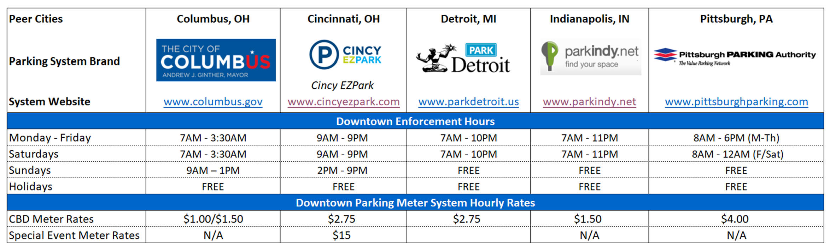
SYSTEM MODERNIZATION PLAN
Parking Rates and Enforcement Policies of Peer Cities:

Slide 11
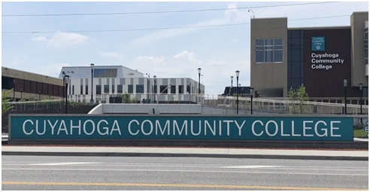
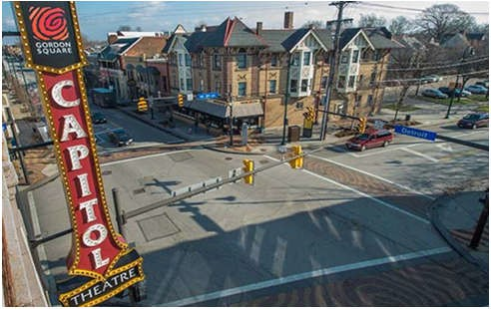
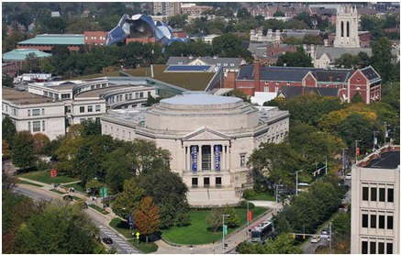
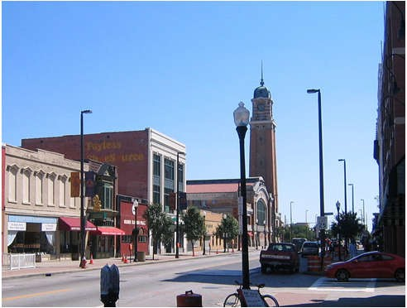
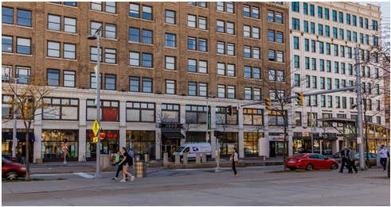
SYSTEM MODERNIZATION PLAN
Phase I Implementation Areas:
Central Business District
Including CSU, Flats East Bank, Lakefront
Central Neighborhood
Tri-C and St. Vincent Hospital area
Ohio City
Westside Market District W. 25th and Lorain Ave. area
Detroit Shoreway
Gordon Square Performing Arts District area
University Circle
Cultural and Institutional District (not Little Italy area

Slide 12
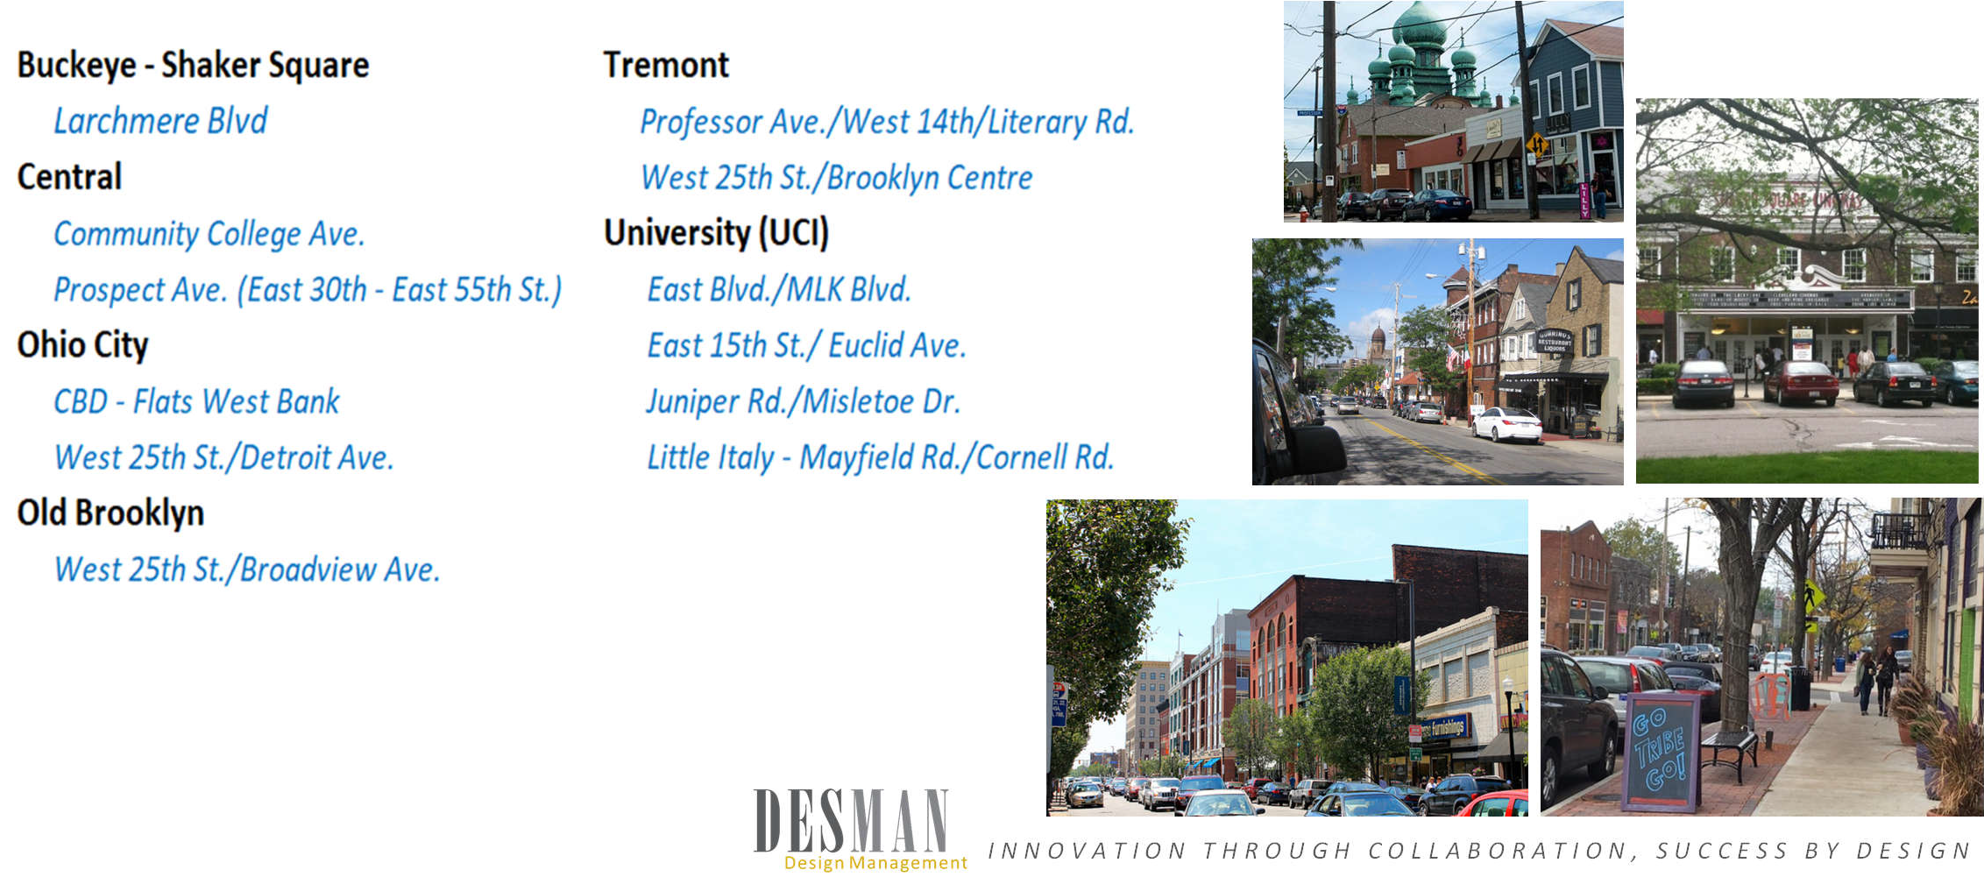
SYSTEM MODERNIZATION PLAN
Phase II Implementation Areas:

Slide 13
SYSTEM MODERNIZATION PLAN
Two-Phase Implementation Strategy:
Meter System Enhancement Plan | CDB | UCI | Ohio City | Detroit Shoreway | Central | All Other Neigh. Areas
Phase I Implementation
Existing Meters Replaced | Yes | Yes | Yes | Yes | Yes | No
Unactive Meters Removed | Yes | Yes | Yes | Yes | Yes | No
Add Meters in New Locations | Yes | No | No | No | No | No
Increase Rates | Yes | No | No | No | No | No
Programmatic Changes | Yes | Yes/ No | Yes/ No | Yes/ No | Yes/ No | No
Phase II Implementation
Existing Meters Replaced |  |  |  |  |  | Yes
Unactive Meters Removed |  |  |  |  |  | Yes
Add Meters in New Locations |  | Yes | Yes | Yes | Yes | Yes
Meters in Off-Street Lots |  |  | Yes | Yes |  | Yes
Increase Rates |  | Yes | Yes | Yes | Yes | Yes
Programmatic Changes | Yes | Yes | Yes | Yes | Yes | Yes/ No

Slide 14
SYSTEM MODERNIZATION PLAN
Two-Phase Implementation Strategy:
COST SUMMARY FOR PROJECT PHASING |  | Future Parking Spaces | New MSPM Units | Estimated Cost of New MSPM Units
Phase I - Existing Meter Upgraded to MSPM Units (CBD & Selected Neighborhoods) |  | 2,428 | 293 | $1,904,500
Phase I - New Pay Parking Zones with MSPM Units (CBD Only) |  | 286 | 40 | $260,000
Phase I - Eliminated Single Space Meters | (35)
PHASE I PLAN SUBTOTALS |  | 2,714 | 333 | $2,164,500
Phase II - Existing Meters Upgraded to MSPM Units |  | 138 | 18 | $117,000
Phase II - New Pay Parking Zones with MSPMs Units |  | 1,617 | 175 | $1,137,500
Phase II - Eliminated Single Space Meters | (42)
PHASE II PLAN SUBTOTALS |  | 1,755 | 193 | $1,254,500
TOTAL PLAN SYSTEM SPACES AND PAY STATION KIOSKS TOTALS |  | 4,469 | 526 | $3,419,000
Subtotal Existing Metered Spaces Upgraded to Multi-Space Pay Station Kiosks Subtotal New Pay to Park Zones with Multi-Space Pay Station Kiosks |  | 2,566 1,903 | 311 215 | $2,021,500 $1,397,500

Slide 15
SYSTEM MODERNIZATION PLAN
Overall Procurement Budget:
CITY OF CLEVELAND METER SYSTEM PROJECT PHASE I Procurement Items | # Units | Estimated Unit Cost | Total
Multi-Space Pay Station Kiosks (Including shipping, installation, warranty, etc.) | 333 | $6,500 | $2,164,500
ALPR Equipped Enforcement Vehicles (including ALPR cameras and software shipping, installation, service, warranty, etc. ) | 6 | $40,000 | $240,000
Pay-by-Phones Services | ----- | $0
PHASE II Procurement Items
Multi-Space Pay Station Kiosks (Including shipping, installation, warranty, etc.) | 193 | $6,500 | $1,254,500
TOTAL PROJECT BUDGET $3,659,000

Slide 16
SYSTEM MODERNIZATION PLAN
Return On Investment:
3- to 4-year return on investment is not uncommon:
Parking meter rates increases (including new special event parking rates)
More convenient payment options
Credit cards drive higher per transaction payments
CBD rate increase conservatively projected to yield over $500,000 annually
Extended parking time limits (fewer 2-hr maximum parking time zones)
Potential for 1,903 new pay to park on-street spaces across the City
Extension of paid parking hours on Friday evenings and on Saturdays
Elimination of piggybacking on unexpired meters
Higher meter payment compliance due to ALPR enforcement

Slide 17
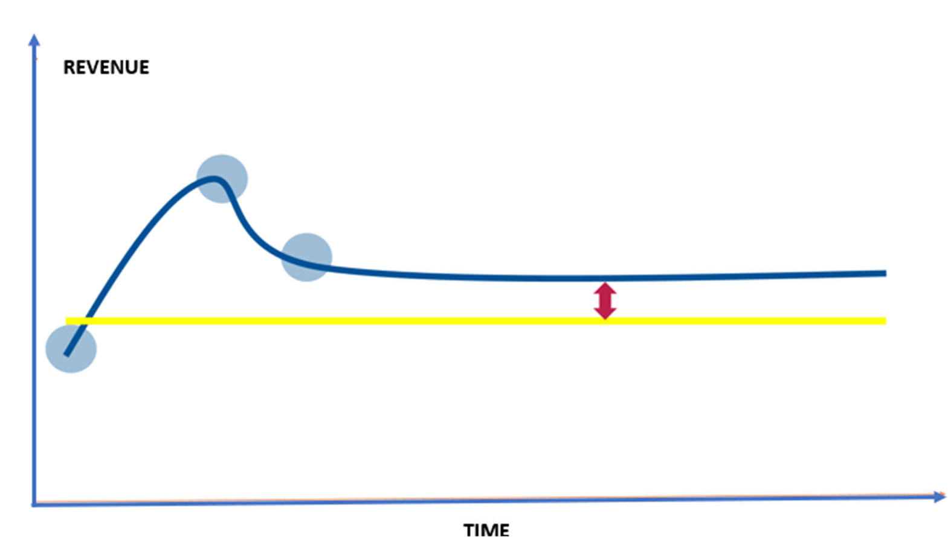
SYSTEM MODERNIZATION PLAN
LPR Technology’s Impact on Citation Revenue:

Slide 18
SYSTEM MODERNIZATION PLAN
Procurement Process:
“RFP” in response performance specifications document
Single contract awarded for multi-faceted package of equipment & services
Competition among industry leading supplies
Sole accountability for on-time delivery of a fully integrated system
Requirement for strong on-going system support
Price lock extension for subsequent purchases
Extended warranty
Product demonstrations
Pre-proposal conference interviews

Slide 19


CITY OF CLEVELAND
Parking Meter System Enhancement Project
Questions

