Slide 1
Lead Safe Auditor
Report to the Lead Safe Advisory Board
City of Cleveland
Period: July-September 2023
December 2023

Slide 2
Report Outline
Context – Zones & Rental Universe
Implementation Progress
Quarterly Metrics
Compliance Findings
Conclusions

Slide 3
Data through June 30, 2023
Cumulative First-Time Applications
  Submitted: 7,342 applications (33,148 units)
  Approved: 6,481 applications (29,030 units)
  Unapproved: 861 applications (4,118 units)
Renewal Applications
  1,094 properties certified in first 3 quarters of rollout (1/1/21-9/30/21) subject to renewal
  As of 9/30/2023: 627 of these (57%) have renewed and 467 have expired
Approx 13% of properties and 28% of rental units in City

Slide 4
Lead Safe Applications Count by Quarter
355 applications in quarter, down 35% from Q2’23 (550)
5th consecutive quarter of decline

Slide 5
Lead Safe Applications Count by Zone
Overall, 88% of applications approved and 12% denied or pending
Early zones showed highest compliance
Zones each comprise approx 6000-7,000 rental properties
Zone | Apps | Units | Approved | Units | Never Approved | Units
1 | 1,424 | 4,377 | 1,294 | 4,135 | 130 | 242
2 | 1,313 | 4,359 | 1,185 | 3,573 | 128 | 786
3 | 1,077 | 3,989 | 938 | 3,456 | 139 | 533
4 | 795 | 4,794 | 699 | 4,414 | 96 | 380
5 | 889 | 2,364 | 795 | 2,093 | 94 | 271
6 | 374 | 4,411 | 288 | 3,422 | 86 | 989
7 | 879 | 7,668 | 777 | 6,741 | 102 | 927
8 | 572 | 1,276 | 478 | 1,116 | 94 | 160
Total | 7,342 | 33,148 | 6,481 | 29,030 | 861 | 4,118

Slide 6
Quarterly Metrics (through 9/30/23)
Lead Safe Certification | Property Count | Units Involved
Initial Certifications submitted | 7,342 | 33,148
Initial Certifications approved | 6,481 | 29,030
Initial Certifications unapproved | 861 | 4,118
Renewal Certifications approved | 627 | 940
Initial Certifications expired | 467 | 701
Properties receiving 20-year LSC | 141 | 3,880

Slide 7
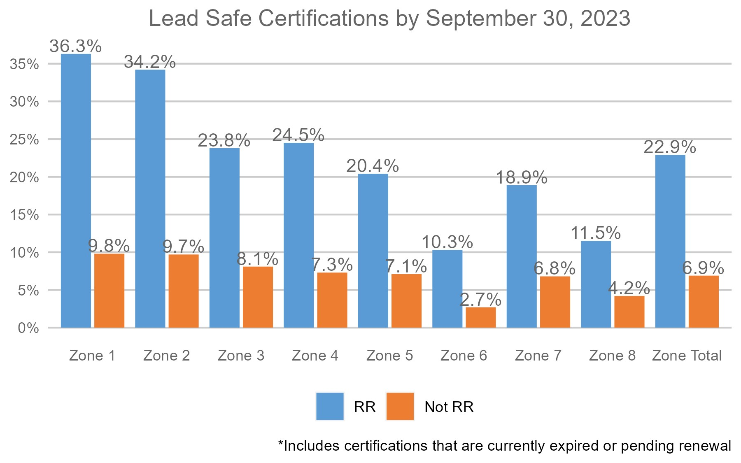
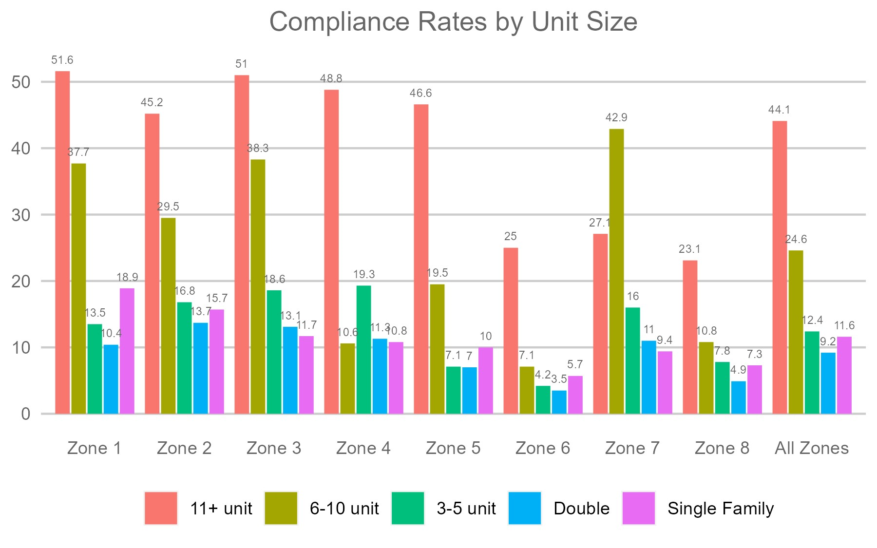
Compliance by Rental Status and Property Size
Larger properties (6 or more units) much 2-4x more likely to be certified
Previously registered rentals 3x more likely to be certified compared to unregistered

Slide 8
Primary Conclusions
Lead safe applications declined in 3rd Quarter 2023 to 355, continuing a concerning five-quarter decline (down from 1,000/qtr in mid 2022)
Application approval rates remain high (88%) but unapproved and denied applications involve over 4,000 units of housing
Renewals among previously certified properties have improved to 57% but 467 certificates have expired suggesting owner ambivalence to continued compliance; continued nonrenewal jeopardizes overall objectives
Overall property compliance trend in line with peer cities, especially among registered rentals, but well below level required to reach full compliance by 2018 (approx. 2,600 new applications per quarter)

Slide 9
Compliance Trend
To reach a 7-year goal of compliance (by 2028), the volume of LSC applications would need to reach approximately 2,600 per quarter
For each quarter that achieves less than 2,500, the quarterly number needed increases
Without high compliance on two-year renewals, overall success is at risk
Current Trend – registered rentals
Current Trend – all rentals

Slide 10
Lead Safe Comment Portal – July 2023 to present
9/23/2023 | Property manager | I have applied to the CHN program for lead safe repair work. It took 6 month for CHN to review the submission and they have yet to schedule a lead assessor to test the property. I know for a fact that there is a lack a RRP certified contractors as I have personally received multiple RFP's. My question is what is the landlord status with the city's proposed laws and potential liability after applying for the program. My experience is 6 months and counting.
11/15/2023 | Lead Risk Assessor | City ordinance 365.04.A.1 states that the 90 day limit starts when the residence has obtained clearance. The Building Department has interpreted this incorrectly. They say the 90 day limit starts when the clearance process begins. All dates are based on the lab certificate dates. There is no time limit to obtain a clearance in any HUD rule or ODH ordinance. This is slowing down the process of obtaining a lead safe certificate.
11/16/2023 | Lead Risk Assessor | Am I allowed to attend the meeting on December 14.?

